Slide 1
Are You Fit for HealthKit?
Igor Kantor
360iDev 2017
Demo App:
https://github.com/Iiiggs/AsthmaBuddy
Notes:
- Hello and Welcome
How is sounds in the back?
If playing along, pull down the app

Slide 2

Igor Kantor
iOS Dev, DaVita, Mobile Community of Excellence
Live in Denver, 4 years
7 month-old baby girl Alexandra ->
Twitter, GitHub: @Iiiggs
Riding century in Buffalo Classic
Notes:
Igor Kantor
Work at DaVita, Mobile Community of Excellence
Patient Engagement and other apps
Certification
Denver for 4 years
New Dad
I have a twitter account
Riding first century next month

Slide 3

Notes:
We are in Colorado
Beautiful mountains, check them out if you have time

Slide 4

Notes:
- Most know about Gold Rush
Got people here starting in 1859
Few got wealth, most spent it in town, gold ran out quickly and they had to move to new spot

Slide 5
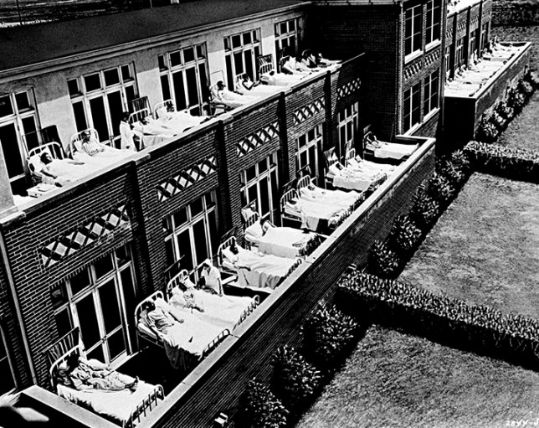
Notes:
- TB top killer of Americans late 1800s to early 1900s
No cure at the time
healthcare providers sent patients to Colorado for clean and dry air
1880s and 1890s, estimated one-third of the people living in Colorado Springs had TB
One estimate, 60 percent of the state’s population in 1925 came to Colorado because of TB.
Fortunately a cure was developed during WW II

Slide 6
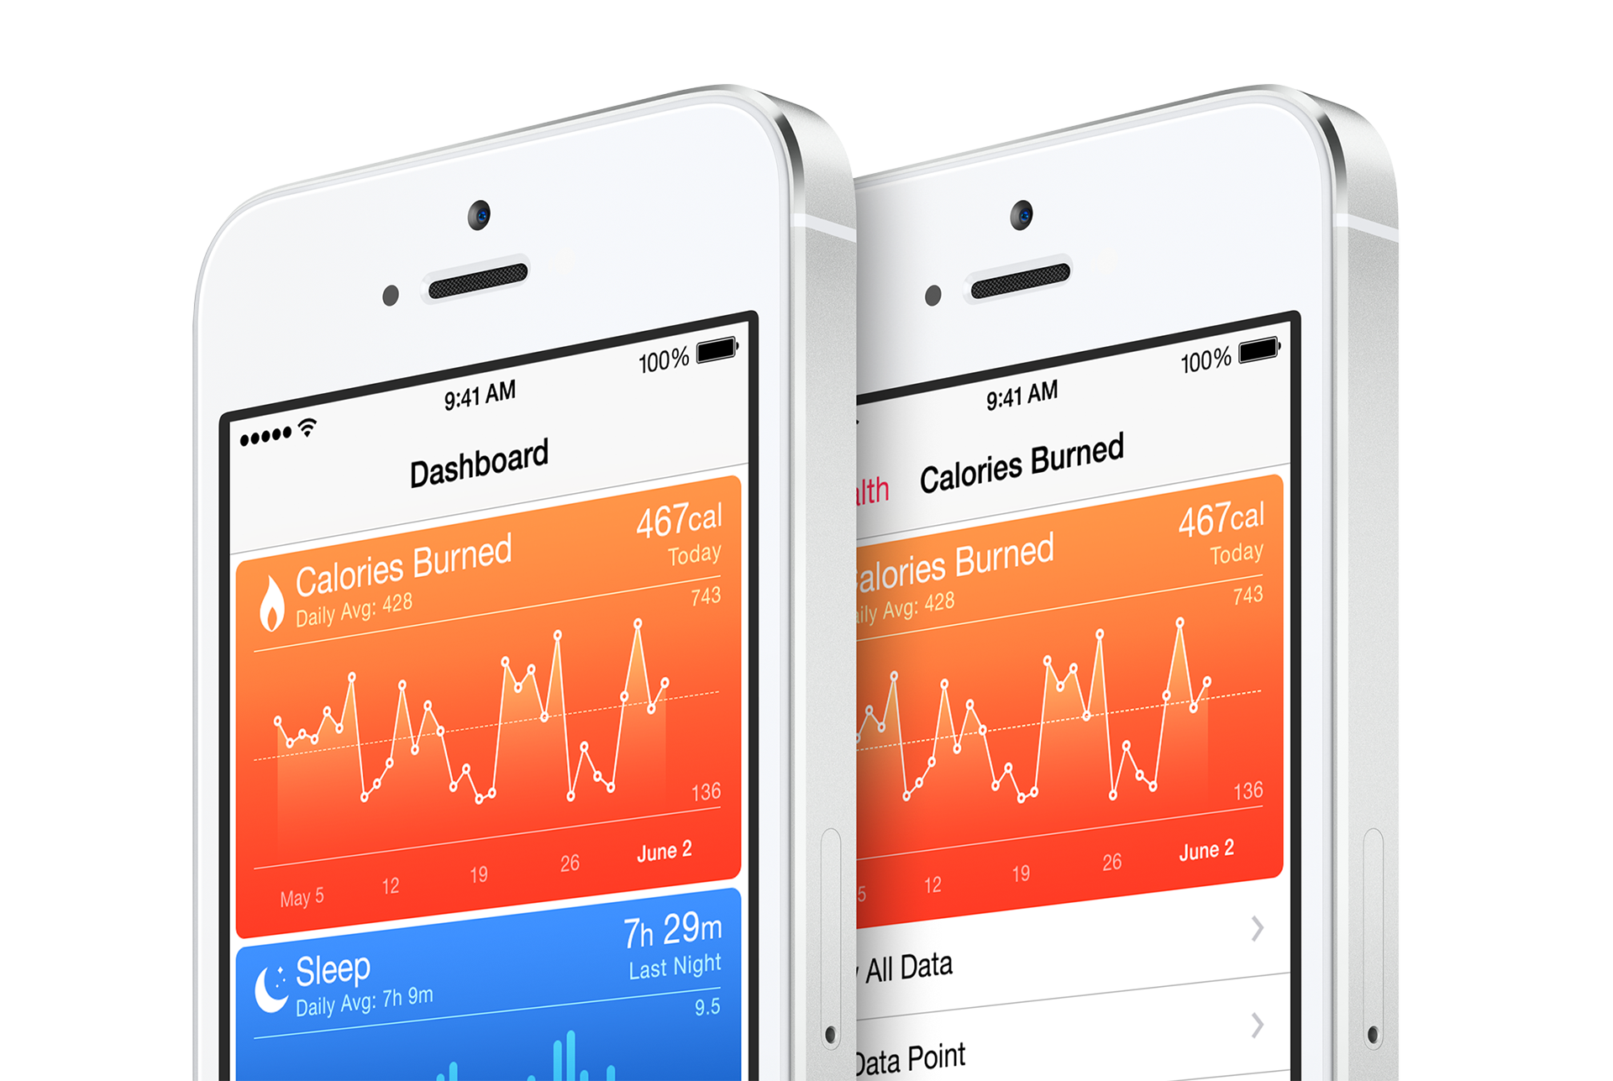
Notes:
Come a long way in both treatment of disease and wellness monitoring
Apple introduced HealthKit in 2014 with iOS 8

Slide 7
https://www.linkedin.com/pulse/connecting-ios-your-emr-using-healthkit-cda-part-two-eric-whitley
Notes:
Data store and set of services
On device
Protected behind Apple’s authorization
Allows for broad range of apps and devices to share/read health and wellness data

Slide 8
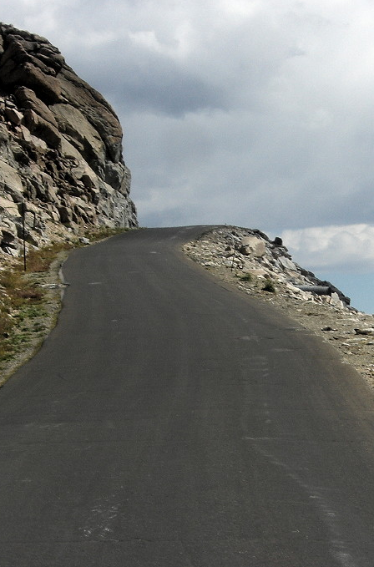
Roadmap
HealthKit Type System Explained
Building AsthmaBuddy with HealthKit, ResearchKit and MapKit
Sample code: https://github.com/Iiiggs/AsthmaBuddy
HIPAA Compliance and You
Notes:
Quick overview of direction for today
Explore type system
Build real-world scenario
Talk a bit about HIPAA and when it may apply

Slide 9
I. HealthKit Types Explained
Notes:
- Nice use of generic types
- Represent variety of data

Slide 10
// HKHealthStore
if (HKHealthStore.isHealthDataAvailable()) {
let healthStore = HKHealthStore()
healthStore.requestAuthorization(
toShare: types,
read: types)
{_,_ in print("check response")}
}
Notes:
Main interface to HealthKit
Check for support
Apple recommends singleton
Request granular authorization
Share = insert
Read = query

Slide 11
// HKObjectType
let dobType = HKObjectType.characteristicType(forIdentifier:
HKCharacteristicTypeIdentifier.dateOfBirth)
let activitySummaryType = HKObjectType.activitySummaryType()
let inhalerUsageType = HKObjectType.quantityType(forIdentifier:
HKQuantityTypeIdentifier.inhalerUsage)
Notes:
Used to describe data type
3 groups of subclasses
Characteristics don’t change
Activity summary is the rings on Apple watch
Sample types have start, end

Slide 12
// HKCharacteristicType
let genderType = HKObjectType.characteristicType(
forIdentifier: HKCharacteristicTypeIdentifier.biologicalSex)
let bloodType = HKObjectType.characteristicType(
forIdentifier: HKCharacteristicTypeIdentifier.bloodType)
let dobType = HKObjectType.characteristicType(
forIdentifier: HKCharacteristicTypeIdentifier.dateOfBirth)
Notes:
- Examples of characteristics
- Can only read

Slide 13
// HKSampleType
let categoryType = HKObjectType.categoryType(
forIdentifier: HKCategoryTypeIdentifier.sleepAnalysis)
let correlationType = HKObjectType.correlationType(
forIdentifier: HKCorrelationTypeIdentifier.bloodPressure)
let quantityType = HKObjectType.quantityType(
forIdentifier: HKQuantityTypeIdentifier.stepCount)
Notes:
Things that do change over
- Sleep analysis: In Bed/Asleep/Awake
- Correlation: 120/80 Blood Pressure
- 1,000 Steps between 7:45 and 9:00
Basketball beteween 10:30 and 12:30
Clinical Document Architecture (XML)

Slide 14
// HKSample
let tenThousandSteps = HKQuantity(
unit: HKUnit.count(),
doubleValue: 10_000.0)
let stepsSample = HKQuantitySample(
type: quantityType,
quantity: tenThousandSteps,
start: startDate,
end: endDate)
healthStore.save(stepsSample)
{ (success, error) in print("check success") }
Notes:
Types not very useful if we can’t save samples
Sample has:
Type
Quantity
Start
End

Slide 15
// HKUnit
let gramUnit = HKUnit.gram()
let meterUnit = HKUnit.meter()
let kiloMeterUnit = HKUnit.meterUnit(with: HKMetricPrefix.kilo)
let hourUnit = HKUnit.hour()
// complex unit
let deciliter = HKUnit.literUnit(with: HKMetricPrefix.deci)
let decilitersPerHour = deciliter.unitDivided(by: hourUnit)
Notes:
standard units (meters, seconds, and grams)
prefixes (centimeters, milliseconds and kilograms)
equivalent non-SI units (feet, minutes, and pounds)
Supports creating complex units by mathematically combining existing units.

Slide 16
// HKQuantity
let twoGrams = HKQuantity(
unit: gramUnit,
doubleValue: 2.0 )
let threeMeters = HKQuantity(
unit: meterUnit,
doubleValue: 3.0 )
let fiveKilometers = HKQuantity(
unit: kiloMeterUnit,
doubleValue: 5.0 )
Notes:
store numerical data
for a given unit
request the value in any compatible units

Slide 17
// HKQuantity Conversion
let feetIn5K = fiveKilometers.doubleValue(
for: HKUnit.foot()
)
let stonesIn2Grams = twoGrams.doubleValue(
for: HKUnit.stone()
)
Notes:
Example of converting HKQuantitity into compatible units
Helpful in any project
Unfortunatly, cannot do arithmetic

Slide 18
// HKWorkout
let workout1 = HKWorkout(
activityType: .basketball,
start: startDate,
end: endDate
)
let workout2 = HKWorkout(
activityType: .cycling,
start: startDate,
end: endDate,
workoutEvents: nil,
totalEnergyBurned: nil,
totalDistance: fiveKilometers,
metadata: nil )
Notes:
Is an HKSample subclass
Use to Share and read workout data
Basketball, cycling, waling, running etc
Optional events, energy burned, distance covered

Slide 19
// HKQuery Types
HKAnchoredObjectQuery
HKCorrelationQuery
HKObserverQuery
HKSampleQuery
HKSourceQuery
HKStatisticsQuery
HKStatisticsCollectionQuery
Notes:
HKAnchoredObjectQuery - Get only new samples using anchor object
HKCorrelationQuery - Query correlated samples- blood pressure
HKObserverQuery - Callback for new samples – also in background
HKSampleQuery - Query for sample data
HKSourceQuery - Sources (apps and devices) of sample type
HKStatisticsQuery - Aggregating (avg/min/max/sum) of sample type
HKStatisticsCollectionQuery - Aggregations with time interval

Slide 20
// HKSampleQuery
let runPredicate =
HKQuery.predicateForWorkouts(with: .running)
let sampleQuery =
HKSampleQuery(
sampleType:workoutType ,
predicate: runPredicate,
limit: 100,
sortDescriptors: nil)
{ (sampleQuery, samples, error) in print(”check error")}
Notes:
Sample query for running activities
Non-workout queries only need an exact type

Slide 21
// HKStatisticsCollectionQuery
var dateComponents = DateComponents()
dateComponents.day = 1
let statisticsCollectionQuery = HKStatisticsCollectionQuery(
quantityType: stepsType,
quantitySamplePredicate: nil,
options: HKStatisticsOptions.cumulativeSum,
anchorDate: startDate,
intervalComponents: dateComponents)
Notes:
Get cumulative sum of steps
From start date
Broken up by day

Slide 22

Missing In HealthKit
HKQuantity math
Data export
Interop with health systems
More HKDocumentSample(s)
Notes:
Few things founds missing from PoC and presentation research
No arithmetic, can unwrap
No data export in CDA
No api for external systems
Only one document sample supported. Missing:
Images
PDFs for resources

Slide 23
II. Build AsthmaBuddy
https://github.com/Iiiggs/AsthmaBuddy
Notes:
- With that overview of types
Hypothetical app scenario
Inhaler usage tracker
The code is yours
Repo also has this deck
Use freely but I provide no warranty
Can be modified for any other healthkit type, see HealthApp for ideas

Slide 24

Roadmap
Ask for permissions to access characteristics + inhaler usage and to write inhaler usage
Read user characteristics: gender and dob
Share inhaler usage sample into HealthKit
Including location metadata
Read inhaler usage
Visualize on line chart
Plot on map
Notes:
Four major pieces of functionality
Authorization
Query characterisitcs
Share inahler usage
Read inhaler usage

Slide 25
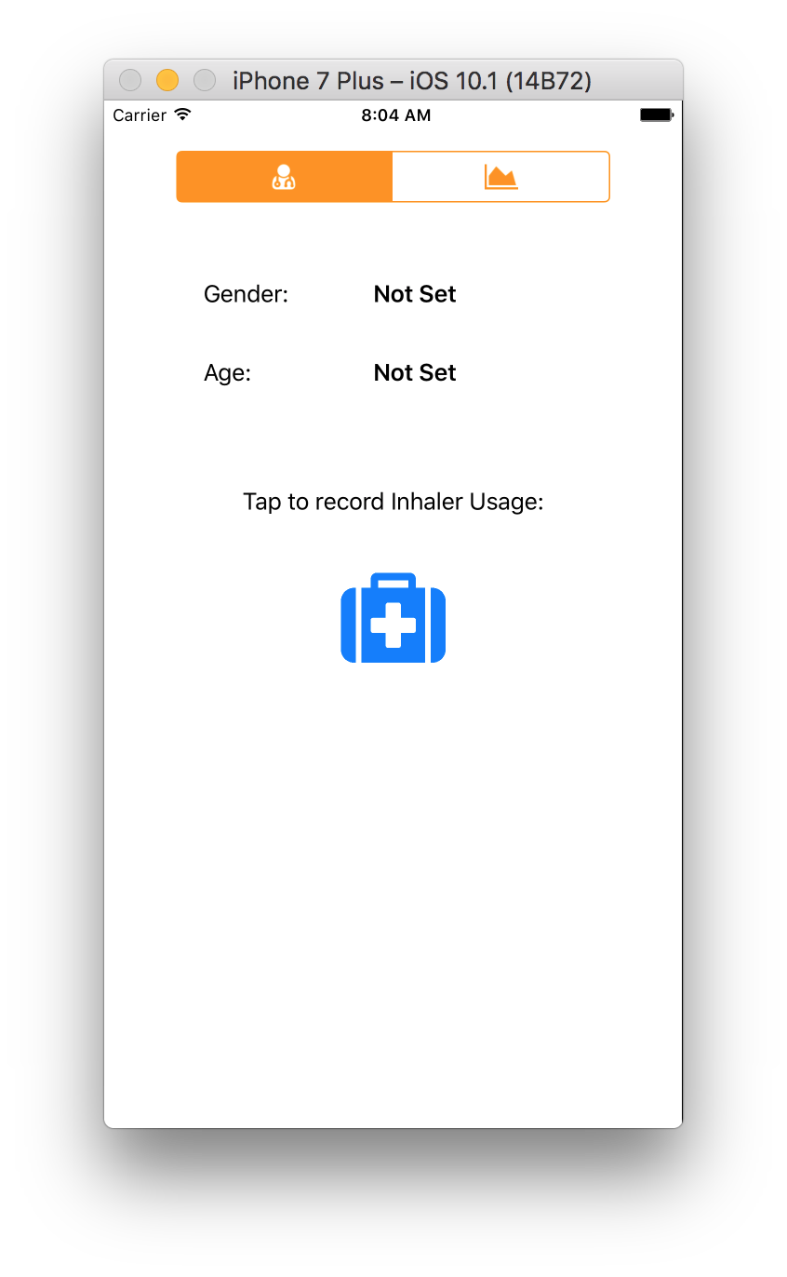
Project Config and Navigation
Link HealthKit/MapKit/ResearchKit
HealthKit in Target’s Capabilities
Info.plist Usage Descriptions
HealthKit Share
HealthKit Update
Location Services - When In Use
Basic Navigation Using Two Embedded View Controllers
Notes:
Config steps already done
ResearchKit is open source
Usage description can be a pain point when getting started
Basic nav with segmented control and embedded VCs
Build and run, should see screenshot

Slide 26
// Wrap Health Store in HealthKitAdapter
class HealthKitAdapter: NSObject {
static let sharedInstance = HealthKitAdapter()
private let healthKitStore = HKHealthStore()
}
Notes:
Navigate to AsthmaBuddy/Shared/HealthKitAdapter.swift
Wraps a singleton Health Store

Slide 27
// I. Authorization
let typesToShare : Set = [inhalerUsageQuantitityType]
let typesToRead : Set = [inhalerUsageQuantitityType,
dobCharacteristicType,
genderCharacteristicType]
if(HKHealthStore.isHealthDataAvailable()){
self.healthKitStore.requestAuthorization(
toShare: typesToShare,
read: typesToRead)
{success, error in
print("check success")
}
}
Notes:
Find “I. Authorization”
Implement init by uncommenting code below the label
Run the app

Slide 28
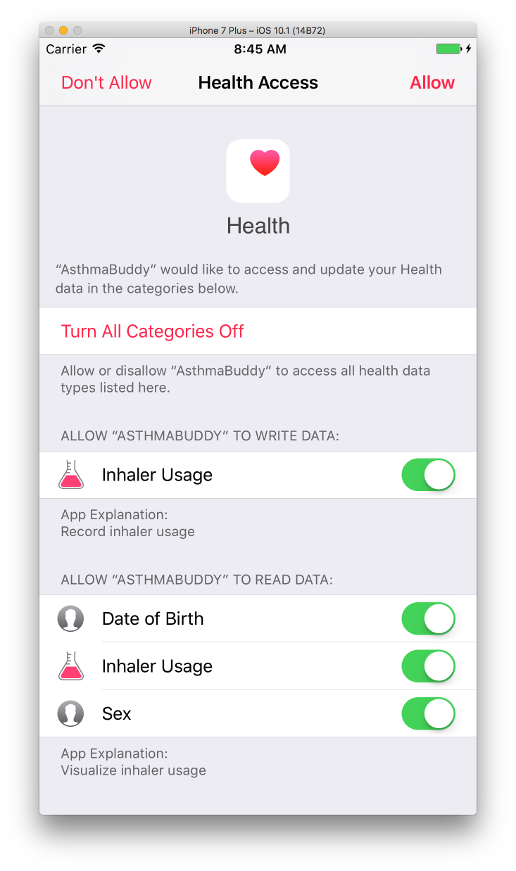
Notes:
Should see authorization sheet like this
If we don’t grant permission, app won’t know if there is sample

Slide 29
// II. Get Characteristics
do {
let dob = try healthKitStore.dateOfBirthComponents().date!
let gender = try healthKitStore.biologicalSex()
completion(dob, gender.biologicalSex)
} catch {
print("Error")
}
Notes:
- Next let’s query for some characteristics
Find II. Get Characteristics
Implement these lines
Wrapped in exception handling
Returns nil if not set or not authorized
Run the app again

Slide 30
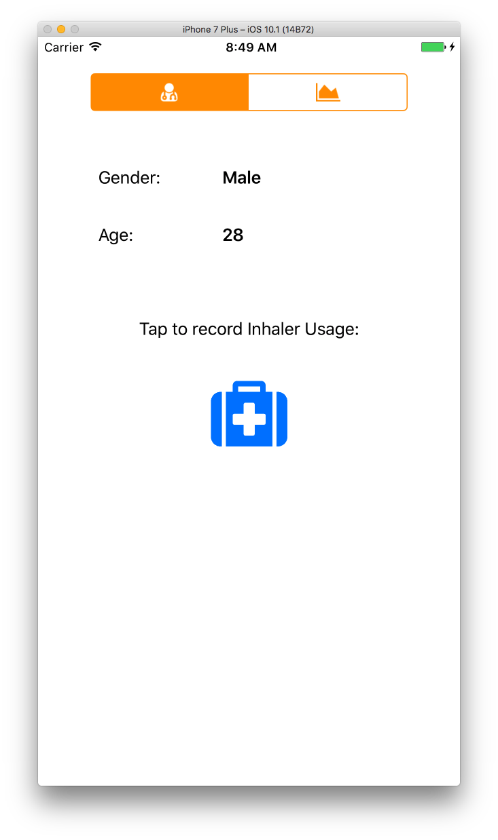
Notes:
Should see gender and age
If “Not Set”, take a look at Health App on simulator and device
Set demographics under profile -> edit

Slide 31
// III. Save samples
let sample = HKQuantitySample(
type: inhalerUsageQuantitityType,
quantity: quantityOne,
start: date,
end: date
)
healthKitStore.save(sample) { (success, error) in
print("saved one use to health kit")
}
Notes:
- Next we share QuantitySample to health store
Find “III. Save samples”
Notice we support with or without location
Without location, create quantity sample from type and quantity, specify date range

Slide 32
Notes:
- Inhaler usage button on profile tab should work, even if you say no to location service

Slide 33
// III. Save samples with location
let coordinateString = "\(lat),\(lon)"
let sample = HKQuantitySample(
type: inhalerUsageQuantitityType,
quantity: quantityOne,
start: date,
end: date,
metadata: [usageLocationKey:coordinateString]
)
healthKitStore.save(sample) { (success, error) in
print("saved one use to health kit, with location")
}
Notes:
Apple’s model for extending HealthKit types is metadata dictionary
Here we have example of packing coordinates into string and saving to metadata
Build and run

Slide 34
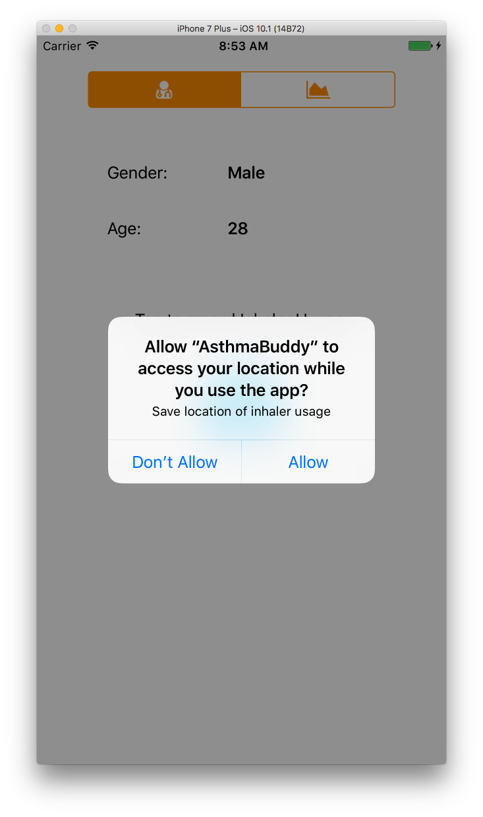
Notes:
Should see prompt for location
Can save some samples
Location is more realistic on device
Did get Denver as custom GPX

Slide 35
// IV: Get data for chart and map
let query = HKSampleQuery(
sampleType: inhalerUsageQuantitityType,
predicate: nil,
limit: 100,
sortDescriptors: nil)
{ (query, samples, error) in
completion(samples as? [HKQuantitySample])
}
self.healthKitStore.execute(query)
Notes:
Get sample data for charts
Specify type and limit
Pass result onto completion handler
Final build and run

Slide 36
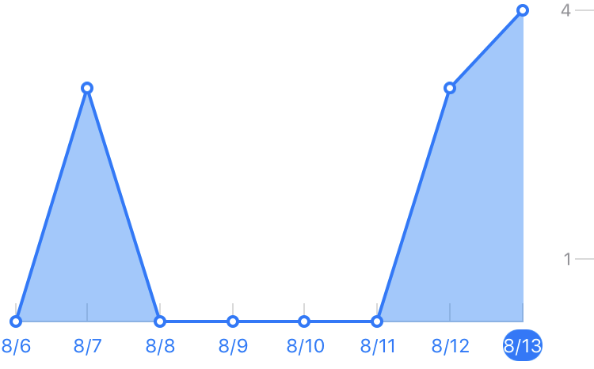
ResearchKit Charts
Line Graph
Value Range Datasource
Point for index
Number of points for plot
Number of plots
Title for X Axis at index
Notes:
Wanted to show a few
ResearchKit has some nice charts
Also has anonymous population tracking
- Easy to work with and nice charts API
- Also has bar charts

Slide 37
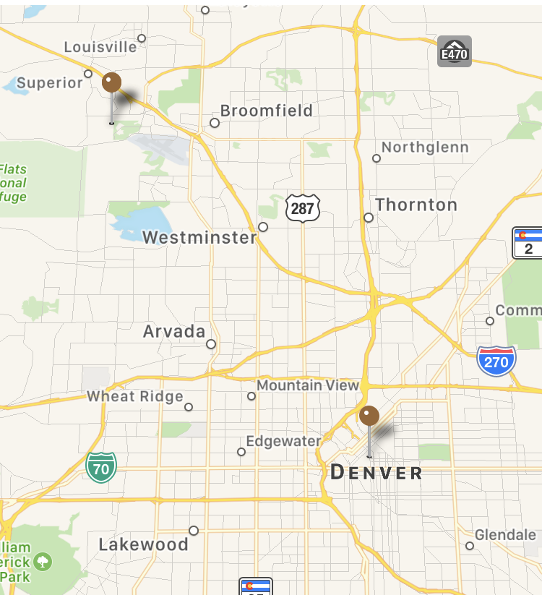
Map Visualization
Map View
Map View Delegate
View for Annotation
Extended HKQuantitySample implement MKAnnotation
Add annotations to Map View
Notes:
MapView with MapKit
Look at Utilities.swift for extenstions to HKQuantitySample to help with this and chart
Showing where in town user used inhaler

Slide 38
Demo
Notes:
- Open AsthmaBuddy and implement HealthKit adapter
- Run with AsthmaBuddyDemo simulator

Slide 39
III. HIPAA And You
Notes:
Quick chat about working with sensitive data
This is a reality once you get into working on health care apps

Slide 40
HIPAA Is…
Health Insurance Portability and Accountability Act of 1996
If applicable, you must:
Protect PHI at rest and in motion
Minimize use and sharing of PHI
Agreements with Business Associates to safeguard PHI
Training and procedures to protect PHI
Notes:
If you haven’t worked for a covered entity previously…
Make sure to be ready for audit

Slide 41
PHI
CHI
Doctor billing
Email to doctor's office about a medication
Appointment with doctor's office
An MRI scan
Blood test results
Pedometer steps
Calories burned
Blood sugar readings w/out personally identifiable information (PII)
Heart rate readings w/out PII
Inhaler usage not shared with Doctor
Notes:
Some context:
Protected health information
Consume health information

Slide 42
Covered Entity and Business Associates
Covered Entity is anyone who provides treatment, payment and operations in healthcare.
Hospital
Dialysis Clinic
Doctor’s Office
Insurance Provider
Business Associate is a vendor or subcontractor who has access to PHI.
Email vendor
Cloud storage provider
Payment platform
Notes:
- Covered entities have been covered since day 1
- Business associates is realtively new (2013)
- Both have to protect PHI

Slide 43
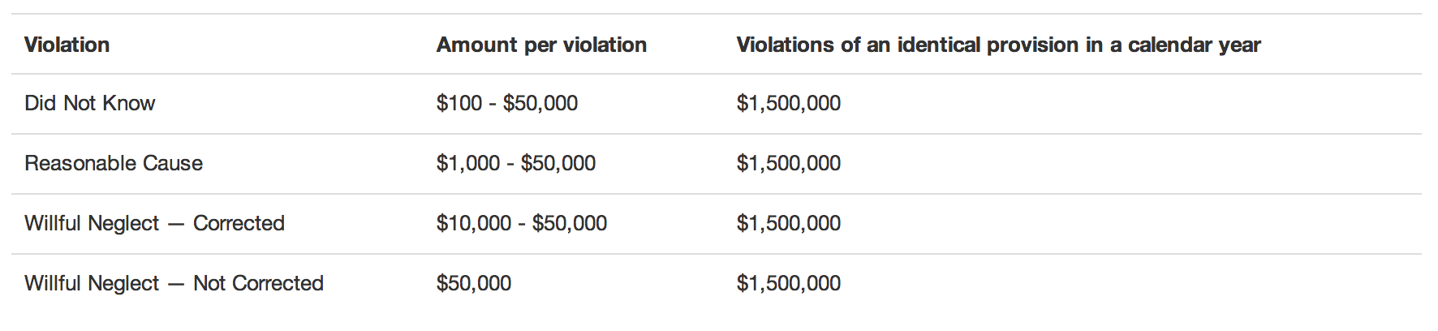
HIPAA Fines
Source: HHS, Federal Register.gov
Notes:
Fines escalate quickly, so make sure to follow guidelines if applicable

Slide 44
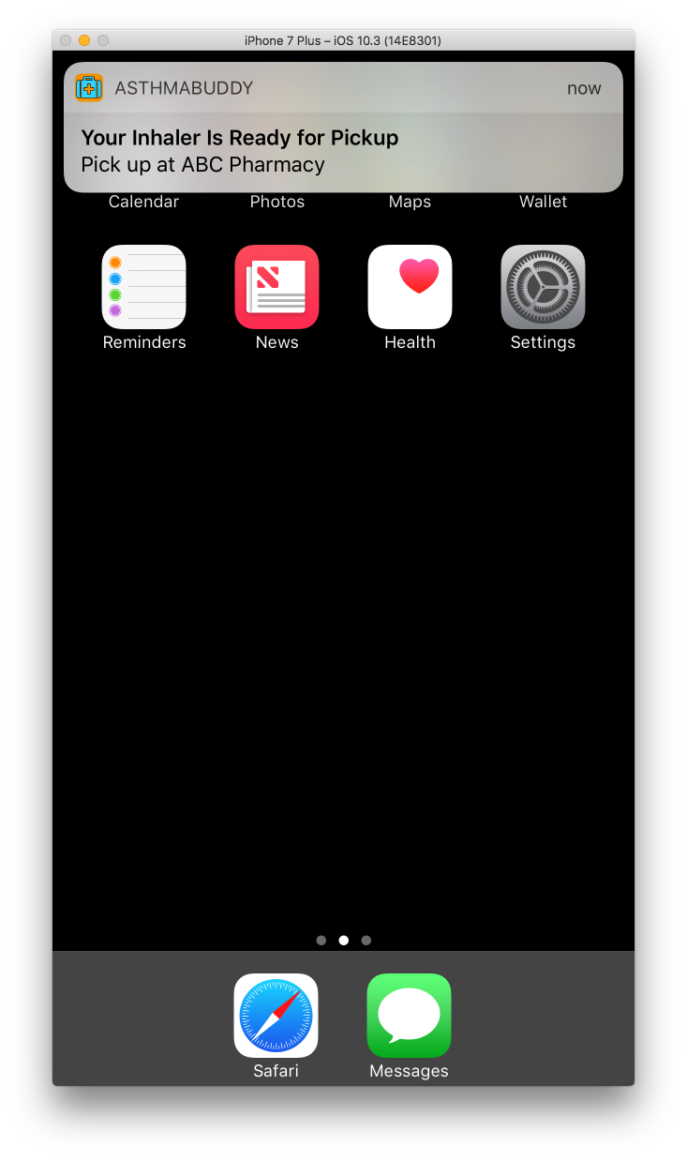
App Stuff
Push Notifications
Emails/automated calls
Integrations
Encryption
Lock screen
Enabling remote wiping of lost phones
Notes:
Some real-world examples where PHI can leak
- Push

Slide 45
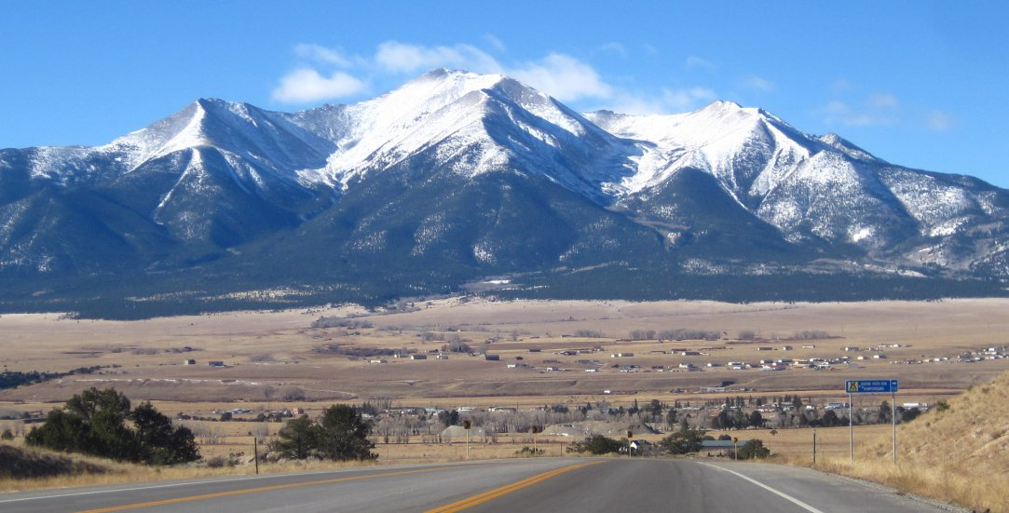
Thank you!
DaVita (MCoE) is hiring iOS and DevOps: http://careers.davita.com
Twitter, GitHub: @Iiiggs
Notes:
- Thank you for your time
- Enjoy the code samples
- Dekc is in the repo on GitHub
- Check out DaVita careers side if you enjoyed any part of this ☺

